Slide 1


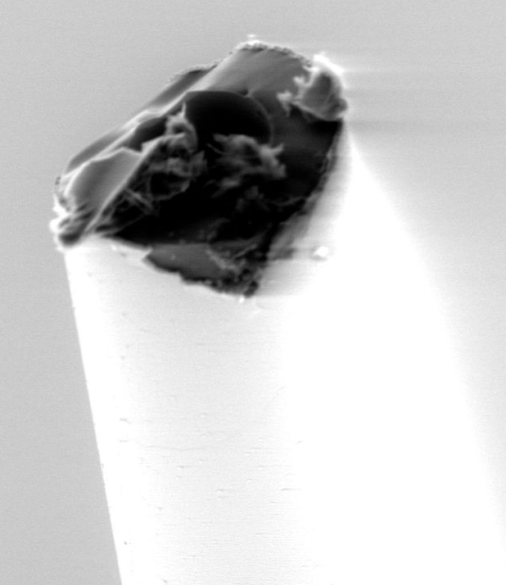
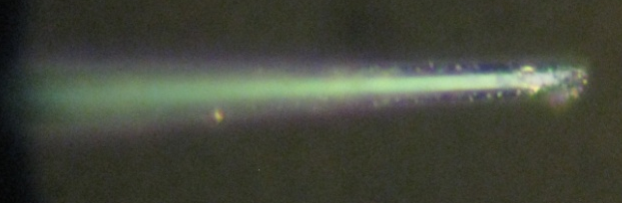
Chemical Vapor Deposition of Tungsten onto the Inside of a Quartz Capillary
for the Creation of a New In Vitro Biosensor
Daniel Engel, Jeffrey Halpern, Clifford Hayman, Dr. Heidi Martin
Case Western Reserve University, Department of Chemical Engineering
Objective
Background
Electrode Connection
Results
To line the inner diameter of a pulled (1-3 micron ID) quartz capillary with tungsten metal
Using this microelectrode, implement a smaller, diamond-based in vitro biosensor
To design a custom reactor to line the inside of a quartz capillary with tungsten metal
Quartz capillaries are a reproducible insulator
Diamond can grow directly on the quartz
  Quartz is non-conductive
Needle-tip geometry is desired
We can grow a 2-4 μm diamond diameter microdisk on the tip of a quartz capillary
Problem: There is currently no electrical connection to the diamond grown at the tip.
  Past attempts to make a functional electrode have been unsuccessful
Potential Solution: Tungsten Deposition
  Deposition of Tungsten Hexacarbonyl
  W(CO)_{6 (g)} + H_{2 (g)} + Heat →
  80% W(s) + 15% C(s) + 5%O (s) +
  unreported gas by-products
CFQ to W(CO)₆ reservoir to Pulled electrode
Figure 5: Desired Result. The tip is sealed with diamond, and is expected to be electrically conductive all the way down to the tip.
X-Y Adjustment
Rationale
Heater connected to 20A power supply
Swagelok connection between Flexible tubing and CFQ
Serotonin does not bind to diamond microeelectrodes, unlike carbon fiber microelectrodes, when using voltammetric techniques
Diamond has lower baseline current than CFE for Fast-Scan Cyclic Voltammetry (FSCV)
With a reduced size (1-3 μm ID), the signal can always be on the scale of FSCV
A new design of an in vitro electrode is necessary to increase reproducibility and decrease fabrication time
With a small enough diamond electrode tip, one can use the tip to conduct voltammetry intracellularly.
While a diamond coated tip at 1-3 μm ID can be produced, it is electrically isolated
Future Plans
Hydrogen/Nitrogen Feed
Repeated diamond growths
Energy Dispersive X-ray Spectroscopy (EDX) on exterior of quartz to determine if tungsten plated on exterior
FSCV to verify electrical connection and no tungsten on exterior
Modifications to reactor
  Mass Flow Controller for Hydrogen and nitrogen flows
  Replace Sputtering gun supply with tungsten coil heater
  Additional Thermocouples near capillary
  Replacement of Teflon Ferrules?
Results
b
Figure 1: Tungsten deposition visible on outside of quartz capillary electrode (a). Suspect unreacted W(CO)₆ as flakes in opening of capillary (b).
Reactor Design
Nitrogen
a
Power Supply with Current and Voltage Readout
UHP Hydrogen
Figure 2: Tungsten deposition on filament of capillary. Appears to have a conformal, radial film of Tungsten metal.
Electrode mated to Tungsten Hexacarbonyl Reservoir
Thermocouple readout
Pressure readout
e
Prior Attempted Methods
Main Shutoff
Figure 3: Diamond clusters (c) deposited on external layer of tungsten (d). This is all deposited on a quartz capillary (e).
  Filling with a conductive solution
  Plating the inside of the capillary with a tungsten or platinum ink
  Electroless plating of copper
  Tungsten Sublimation
  Deposition and subsequent breakdown of
    Tungsten Nanoparticles (W)
    Tungsten Oxide (WO₃)
Exhaust
d
Notes on reactor design:
Pressure: () mTorr, 375-500°C Temperature
Because of the crucible, undeposited tungsten is ejected from the tip of the capillary and deposited on the exterior of the capillary
c
Acknowledgements
Figure 3: Optical image of deposition. Image post diamond growth at 1000x. Sealed tip visible, likely plugged with diamond nanoparticles.
Thank you to the Swagelok Center for Surface Analysis of Materials, Support of Undergraduate Research and Creative Endeavors (SOURCE), and the Martin Lab for all of their assistance
Notes:
Answer cliff question 1

